Slide 1
Chapter 2 Testing Throughout the Software Life Cycle
Software Development Model
Waterfall Model
Spiral Model
V Model
Iterative Model
Incremental Model
Test Levels (Unit, Integration, System, UAT)
Test Types (Functional and Non Functional Testing)
Retesting and Regression Testing
Smoke and Sanity Testing
Maintenance Testing

Slide 2
SDLC Model

Slide 3
Waterfall Model
The Waterfall Model was first Process Model to be introduced. It is also referred to as a linear-sequential life cycle model. It is very simple to understand and use. In a waterfall model, each phase must be completed before the next phase can begin and there is no overlapping in the phases.
Waterfall model is the earliest SDLC approach that was used for software development .
The waterfall Model illustrates the software development process in a linear sequential flow; hence it is also referred to as a linear-sequential life cycle model. This means that any phase in the development process begins only if the previous phase is complete. In waterfall model phases do not overlap.

Slide 4
Waterfall Model design
Waterfall approach was first SDLC Model to be used widely in Software Engineering to ensure success of the project. In "The Waterfall" approach, the whole process of software development is divided into separate phases. In Waterfall model, typically, the outcome of one phase acts as the input for the next phase sequentially.
Following is a diagrammatic representation of different phases of waterfall model.

Slide 5
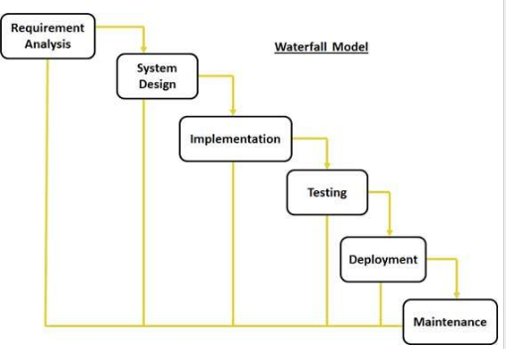
Waterfall Model

Slide 6
The sequential phases in Waterfall model are:
Requirement Gathering and analysis: All possible requirements of the system to be developed are captured in this phase and documented in a requirement specification doc.
System Design: The requirement specifications from first phase are studied in this phase and system design is prepared. System Design helps in specifying hardware and system requirements and also helps in defining overall system architecture.

Slide 7
Implementation: With inputs from system design, the system is first developed in small programs called units, which are integrated in the next phase. Each unit is developed and tested for its functionality which is referred to as Unit Testing.
Integration and Testing: All the units developed in the implementation phase are integrated into a system after testing of each unit. Post integration the entire system is tested for any faults and failures.

Slide 8
Deployment of system: Once the functional and non functional testing is done, the product is deployed in the customer environment or released into the market.
Maintenance: There are some issues which come up in the client environment. To fix those issues patches are released. Also to enhance the product some better versions are released. Maintenance is done to deliver these changes in the customer environment.

Slide 9
All these phases are cascaded to each other in which progress is seen as flowing steadily downwards (like a waterfall) through the phases. The next phase is started only after the defined set of goals are achieved for previous phase and it is signed off, so the name "Waterfall Model". In this model phases do not overlap.

Slide 10
Waterfall Model Application
Every software developed is different and requires a suitable SDLC approach to be followed based on the internal and external factors. Some situations where the use of Waterfall model is most appropriate are:
Requirements are very well documented, clear and fixed.
Product definition is stable.
Technology is understood and is not dynamic.
There are no ambiguous requirements.
Ample resources with required expertise are available to support the product.
The project is short.

Slide 11
Waterfall Model Pros & Cons
Advantage
The advantage of waterfall development is that it allows for departmentalization and control. A schedule can be set with deadlines for each stage of development and a product can proceed through the development process model phases one by one.
Development moves from concept, through design, implementation, testing, installation, troubleshooting, and ends up at operation and maintenance. Each phase of development proceeds in strict order.

Slide 12
Disadvantage
The disadvantage of waterfall development is that it does not allow for much reflection or revision. Once an application is in the testing stage, it is very difficult to go back and change something that was not well-documented or thought upon in the concept stage.

Slide 13
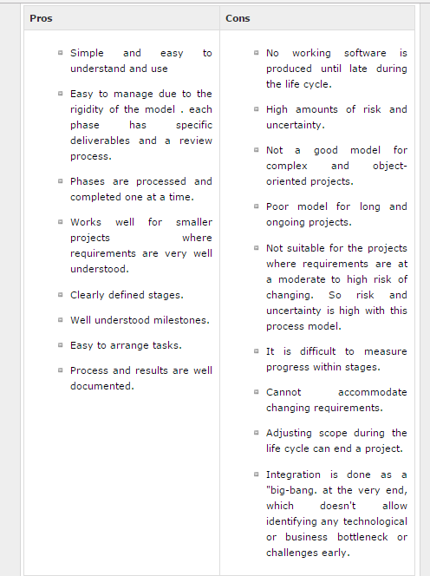

Slide 14
SDLC - Spiral Model
The spiral model combines the idea of iterative development with the systematic, controlled aspects of the waterfall model.
Spiral model is a combination of iterative development process model and sequential linear development model i.e. waterfall model with very high emphasis on risk analysis.
It allows for incremental releases of the product, or incremental refinement through each iteration around the spiral.

Slide 15
Spiral Model design
The spiral model has four phases. A software project repeatedly passes through these phases in iterations called Spirals.
Identification:This phase starts with gathering the business requirements in the baseline spiral. In the subsequent spirals as the product matures, identification of system requirements, subsystem requirements and unit requirements are all done in this phase.
This also includes understanding the system requirements by continuous communication between the customer and the system analyst. At the end of the spiral the product is deployed in the identified market.

Slide 16
Design:
Design phase starts with the conceptual design in the baseline spiral and involves architectural design, logical design of modules, physical product design and final design in the subsequent spirals.
Construct or Build:Construct phase refers to production of the actual software product at every spiral. In the baseline spiral when the product is just thought of and the design is being developed a POC (Proof of Concept) is developed in this phase to get customer feedback.
Then in the subsequent spirals with higher clarity on requirements and design details a working model of the software called build is produced with a version number. These builds are sent to customer for feedback.

Slide 17
Evaluation and Risk Analysis
:Risk Analysis includes identifying, estimating, and monitoring technical feasibility and management risks, such as schedule slippage and cost overrun. After testing the build, at the end of first iteration, the customer evaluates the software and provides feedback.
Following is a diagrammatic representation of spiral model listing the activities in each phase:

Slide 18
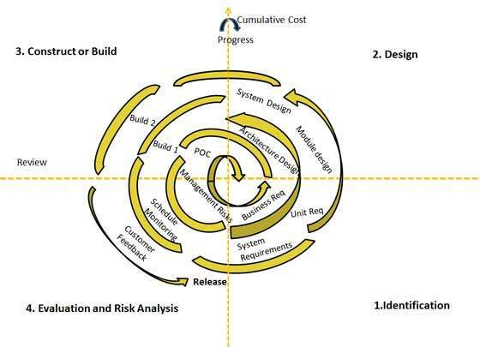

Slide 19
Based on the customer evaluation, software development process enters into the next iteration and subsequently follows the linear approach to implement the feedback suggested by the customer. The process of iterations along the spiral continues throughout the life of the software.

Slide 20
Spiral Model Application
Spiral Model is very widely used in the software industry as it is in synch with the natural development process of any product i.e. learning with maturity and also involves minimum risk for the customer as well as the development firms. Following are the typical uses of Spiral model:
When costs there is a budget constraint and risk evaluation is important.
For medium to high-risk projects.
Long-term project commitment because of potential changes to economic priorities as the requirements change with time.
Customer is not sure of their requirements which is usually the case.
Requirements are complex and need evaluation to get clarity.
New product line which should be released in phases to get enough customer feedback.
Significant changes are expected in the product during the development cycle.

Slide 21
Spiral Model Pros and Cons
The advantage of spiral lifecycle model is that it allows for elements of the product to be added in when they become available or known. This assures that there is no conflict with previous requirements and design.
This method is consistent with approaches that have multiple software builds and releases and allows for making an orderly transition to a maintenance activity. Another positive aspect is that the spiral model forces early user involvement in the system development effort.
On the other side, it takes very strict management to complete such products and there is a risk of running the spiral in indefinite loop. So the discipline of change and the extent of taking change requests is very important to develop and deploy the product successfully.

Slide 22
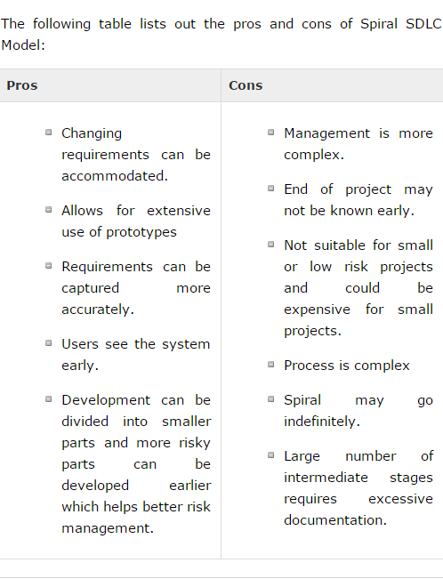

Slide 23
SDLC - V-Model
The V - model is SDLC model where execution of processes happens in a sequential manner in V-shape. It is also known as Verification and Validation model.
V - Model is an extension of the waterfall model and is based on association of a testing phase for each corresponding development stage. This means that for every single phase in the development cycle there is a directly associated testing phase. This is a highly disciplined model and next phase starts only after completion of the previous phase.

Slide 24
V- Model design
Under V-Model, the corresponding testing phase of the development phase is planned in parallel. So there are Verification phases on one side of the .V. and Validation phases on the other side. Coding phase joins the two sides of the V-Model.
The below figure illustrates the different phases in V-Model of SDLC.

Slide 25
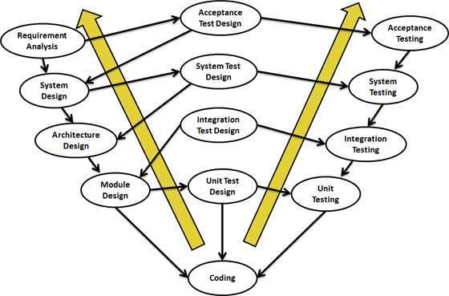

Slide 26
Verification Phases
Following are the Verification phases in V-Model:
Business Requirement Analysis: This is the first phase in the development cycle where the product requirements are understood from the customer perspective. This phase involves detailed communication with the customer to understand his expectations and exact requirement. This is a very important activity and need to be managed well, as most of the customers are not sure about what exactly they need. The acceptance test design planning is done at this stage as business requirements can be used as an input for acceptance testing.

Slide 27
System Design:
Once you have the clear and detailed product requirements, it.s time to design the complete system. System design would comprise of understanding and detailing the complete hardware and communication setup for the product under development. System test plan is developed based on the system design. Doing this at an earlier stage leaves more time for actual test execution later.
Architectural Design:
Architectural specifications are understood and designed in this phase. Usually more than one technical approach is proposed and based on the technical and financial feasibility the final decision is taken. System design is broken down further into modules taking up different functionality. This is also referred to as High Level Design (HLD).

Slide 28
The data transfer and communication between the internal modules and with the outside world (other systems) is clearly understood and defined in this stage. With this information, integration tests can be designed and documented during this stage.
Module Design:In this phase the detailed internal design for all the system modules is specified, referred to as Low Level Design (LLD). It is important that the design is compatible with the other modules in the system architecture and the other external systems. Unit tests are an essential part of any development process and helps eliminate the maximum faults and errors at a very early stage. Unit tests can be designed at this stage based on the internal module designs.

Slide 29
Coding Phase
The actual coding of the system modules designed in the design phase is taken up in the Coding phase. The best suitable programming language is decided based on the system and architectural requirements. The coding is performed based on the coding guidelines and standards. The code goes through numerous code reviews and is optimized for best performance before the final build is checked into the repository.

Slide 30
Validation Phases
Following are the Validation phases in V-Model:
Unit Testing: Unit tests designed in the module design phase are executed on the code during this validation phase. Unit testing is the testing at code level and helps eliminate bugs at an early stage, though all defects cannot be uncovered by unit testing.
Integration Testing: Integration testing is associated with the architectural design phase. Integration tests are performed to test the coexistence and communication of the internal modules within the system.

Slide 31
System Testing:
System testing is directly associated with the System design phase. System tests check the entire system functionality and the communication of the system under development with external systems. Most of the software and hardware compatibility issues can be uncovered during system test execution.
Acceptance Testing: Acceptance testing is associated with the business requirement analysis phase and involves testing the product in user environment. Acceptance tests uncover the compatibility issues with the other systems available in the user environment. It also discovers the non functional issues such as load and performance defects in the actual user environment.

Slide 32
V- Model Application
V- Model application is almost same as waterfall model, as both the models are of sequential type. Requirements have to be very clear before the project starts, because it is usually expensive to go back and make changes. This model is used in the medical development field, as it is strictly disciplined domain. Following are the suitable scenarios to use V-Model:
Requirements are well defined, clearly documented and fixed.
Product definition is stable.
Technology is not dynamic and is well understood by the project team.
There are no ambiguous or undefined requirements.
The project is short.

Slide 33
V- Model Pros and Cons
The advantage of V-Model is that it.s very easy to understand and apply. The simplicity of this model also makes it easier to manage. The disadvantage is that the model is not flexible to changes and just in case there is a requirement change, which is very common in today.s dynamic world, it becomes very expensive to make the change.

Slide 34
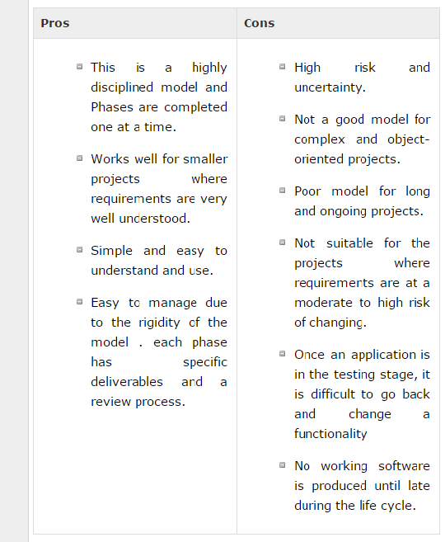

Slide 35
Iterative Model

Slide 36
In the Iterative model, iterative process starts with a simple implementation of a small set of the software requirements and iteratively enhances the evolving versions until the complete system is implemented and ready to be deployed.
An iterative life cycle model does not attempt to start with a full specification of requirements. Instead, development begins by specifying and implementing just part of the software, which is then reviewed to identify further requirements. This process is then repeated, producing a new version of the software at the end of each iteration of the model.

Slide 37
Iterative Model - Design
Iterative process starts with a simple implementation of a subset of the software requirements and iteratively enhances the evolving versions until the full system is implemented. At each iteration, design modifications are made and new functional capabilities are added. The basic idea behind this method is to develop a system through repeated cycles (iterative) and in smaller portions at a time (incremental).
The following illustration is a representation of the Iterative and Incremental model −

Slide 38
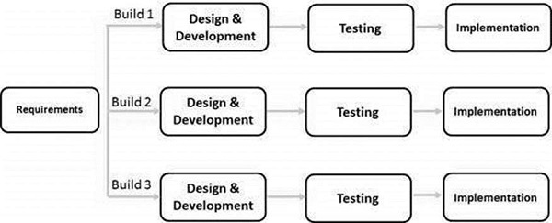
The following illustration is a representation of the Iterative and Incremental model −

Slide 39
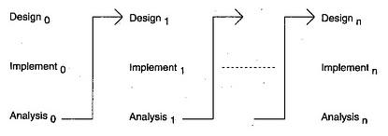
Diagram of Iterative model:

Slide 40
Iterative and Incremental development is a combination of both iterative design or iterative method and incremental build model for development. "During software development, more than one iteration of the software development cycle may be in progress at the same time." This process may be described as an "evolutionary acquisition" or "incremental build" approach."

Slide 41
In this incremental model, the whole requirement is divided into various builds. During each iteration, the development module goes through the requirements, design, implementation and testing phases. Each subsequent release of the module adds function to the previous release. The process continues till the complete system is ready as per the requirement.

Slide 42
The key to a successful use of an iterative software development lifecycle is rigorous validation of requirements, and verification & testing of each version of the software against those requirements within each cycle of the model. As the software evolves through successive cycles, tests must be repeated and extended to verify each version of the software.

Slide 43
Iterative Model - Application
Like other SDLC models, Iterative and incremental development has some specific applications in the software industry. This model is most often used in the following scenarios −
Requirements of the complete system are clearly defined and understood.
Major requirements must be defined; however, some functionalities or requested enhancements may evolve with time.
There is a time to the market constraint.
A new technology is being used and is being learnt by the development team while working on the project.
Resources with needed skill sets are not available and are planned to be used on contract basis for specific iterations.
There are some high-risk features and goals which may change in the future.

Slide 44
Iterative Model - Pros and Cons
The advantage of this model is that there is a working model of the system at a very early stage of development, which makes it easier to find functional or design flaws. Finding issues at an early stage of development enables to take corrective measures in a limited budget.
The disadvantage with this SDLC model is that it is applicable only to large and bulky software development projects. This is because it is hard to break a small software system into further small serviceable increments/modules.

Slide 45
The advantages of the Iterative and Incremental SDLC Model are as follows −
Some working functionality can be developed quickly and early in the life cycle.
Results are obtained early and periodically.
Parallel development can be planned.
Progress can be measured.
Less costly to change the scope/requirements.
Testing and debugging during smaller iteration is easy.
Risks are identified and resolved during iteration; and each iteration is an easily managed milestone.

Slide 46
Easier to manage risk - High risk part is done first.
With every increment, operational product is delivered.
Issues, challenges and risks identified from each increment can be utilized/applied to the next increment.
Risk analysis is better.
It supports changing requirements.
Initial Operating time is less.
Better suited for large and mission-critical projects.
During the life cycle, software is produced early which facilitates customer evaluation and feedback

Slide 47
The disadvantages of the Iterative and Incremental SDLC Model are as follows −
More resources may be required.
Although cost of change is lesser, but it is not very suitable for changing requirements.
More management attention is required.
System architecture or design issues may arise because not all requirements are gathered in the beginning of the entire life cycle.
Defining increments may require definition of the complete system.
Not suitable for smaller projects.
Management complexity is more.
End of project may not be known which is a risk.
Highly skilled resources are required for risk analysis.
Projects progress is highly dependent upon the risk analysis phase.

Slide 48
Incremental Model

Slide 49
In incremental model the whole requirement is divided into various builds. Multiple development cycles take place here, making the life cycle a “multi-waterfall” cycle. Cycles are divided up into smaller, more easily managed modules. Incremental model is a type of software development model like V-model, Agile model etc.

Slide 50
In this model, each module passes through the requirements, design, implementation and testing phases. A working version of software is produced during the first module, so you have working software early on during the software life cycle. Each subsequent release of the module adds function to the previous release. The process continues till the complete system is achieved.

Slide 51

In the diagram above when we work incrementally we are adding piece by piece but expect that each piece is fully finished. Thus keep on adding the pieces until it’s complete. As in the image above a person has thought of the application. Then he started building it and in the first iteration the first module of the application or product is totally ready and can be demoed to the customers. Likewise in the second iteration the other module is ready and integrated with the first module. Similarly, in the third iteration the whole product is ready and integrated. Hence, the product got ready step by step.

Slide 52
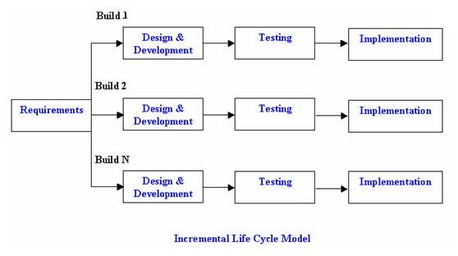
Diagram of Incremental model:

Slide 53
Advantages of Incremental model:
Generates working software quickly and early during the software life cycle.
This model is more flexible – less costly to change scope and requirements.
It is easier to test and debug during a smaller iteration.
In this model customer can respond to each built.
Lowers initial delivery cost.
Easier to manage risk because risky pieces are identified and handled during it’d iteration.

Slide 54
Disadvantages of Incremental model:
Needs good planning and design.
Needs a clear and complete definition of the whole system before it can be broken down and built incrementally.
Total cost is higher than waterfall.

Slide 55
When to use the Incremental model:
This model can be used when the requirements of the complete system are clearly defined and understood.
Major requirements must be defined; however, some details can evolve with time.
There is a need to get a product to the market early.
A new technology is being used
Resources with needed skill set are not available
There are some high risk features and goals.

Slide 56
Test Levels

Slide 57
It is done during or at the end of the development process to determine whether the product satisfies specified requirements.
Validation and verification processes goes hand in hand but visibly validation process starts after verification process ends ( After coding of the product ends)

Slide 58
Validation
The phases involved in validation process are:
1) Code Validation/ Code Testing
2) Integration Validation/ Integration Testing
3) Functional Validation/ Functional Testing
4) System or User Acceptance Validation( UA Testing)

Slide 59
Validation
Unit Testing
Developer
Integration Testing
Developer/ Tester
System Testing
Tester
User Acceptance Testing
User

Slide 60
1)Unit Testing
Unit Testing is the small piece of software that can be tested in isolation Testing of such unit is called Unit Testing.
It is a procedure used to validate that individual unit of source code is working properly.

Slide 61
Approaches
Black Box
White Box
Benefits:
Ensures code meets the requirements.
Simplifies integration

Slide 62
Unit Testing
Interface
Local Data structure
Boundary Condition
Independent Paths
Error Handling
Test Case
Result
Module (One Unit)

Slide 63
Integration Testing
Starts at module level when various module are integrated with each other to form a sub- system or system.
More stress is given on interface between the module. Focuses on design and construction of software architecture.

Slide 64
Integration Testing
Four basic approaches to testing while integration module.
1. Bottom Up Integration Testing
2. Top Down Integration Testing
3. Critical Part first Integration Testing
4. Big Bang Integration Testing

Slide 65
1. Bottom Up
The Program is combined and tested from the bottom of tree to the top.
Requires a MODULE DRIVER for each module put together sub trees and test unit whole tree.
Very common and effective approach especially when combined with oo design.
Each component at the lowest level of the system hierarchy is tested individually first, then next component to be tested You can starts with the DB or network Layer.

Slide 66
Component Driver
Driver are simple programs or calling module designed specifically for testing that make calls to these lower layer or low level component.
Developed for temporary use.
It has to be replaced when the actual top level modules is ready

Slide 67
Leave Management System:
Apply Leave
Approve Leave
Driver

Slide 68
Pros- Cons
Pros
Completeness each piece being tested is complete in itself.
Advantages if major flaws occur towards the bottom of the program.
Test condition are easier to create.

Slide 69
Cons
Driver modules must be produced.
The program as an entity does not exit until the last module is added.
Major control and decision problems will be identified later in the testing phase.

Slide 70
Top Down
Top Down integration is an increment al approach to construction of program structure.
Design to implement and test the top module using stubs (dummy modules)
Module are implemented by moving down words in control hierarchy, beginning with main control module.
For substituting lower modules, stubs are used.
The special purpose program is called as a stub.

Slide 71
If the lowest level of the component performs the input and output operations stubs for them may be almost identical to the actual component they replace.

Slide 72
Leave Management System:
Approve Leave
Create a Leave Report
Stub

Slide 73
Pros
Any design faults or major questions about functional feasibility can be addressed at the beginning of testing instead of that.
Early skeleton program allows demonstration and boast moral.

Slide 74
Cons
Writing stub can be difficult because they must allow all possible condition to be tested.
Stub may itself needed to be tested to ensure it is correct.
Very large no of stubs may be required.

Slide 75
Critical Path First
Design, Implement and test the critical part of the system first.
Important for time critical system, where the performance of critical part makes up for performance of the whole system.
Concentrating on entire application in not always possible, due to limitations of time and resources.

Slide 76
The Optimal way of testing is to concentrate on critical part of the system first.
The critical module can be identified as
Addresses several software requirements
Resides relatively high on program structure .
Complex logic.
Has definite performance requiremets.

Slide 77
Big Bang
A common approach in non process oriented organization.
All modules are integrated at once.
The big bang module is based on the theory in which universe was created in a single huge explosion of infinite energy.
All efforts is spent in developing the s/w and writing code.
In this model max no of people, resources are put together are put together to built up the product.

Slide 78
Pros
It is very simple to understand.
A very little planning, scheduling and formal development.
Process is not required.
No formal testing is done.
No stubs and drivers is required.

Slide 79
Cons
Hard to debug, hard to check interface.
Location of defects is difficult to handle.
Very difficult to fix bugs.

Slide 80
System Testing?
System Testing (ST) is a black box testing technique performed to evaluate the complete system the system's compliance against specified requirements. In System testing, the functionalities of the system are tested from an end-to-end perspective.
System Testing is usually carried out by a team that is independent of the development team in order to measure the quality of the system unbiased. It includes both functional and Non-Functional testing.

Slide 81
System Testing is a level of the software testing where a complete and integrated software is tested.
The purpose of this test is to evaluate the system’s compliance with the specified requirements.

Slide 82
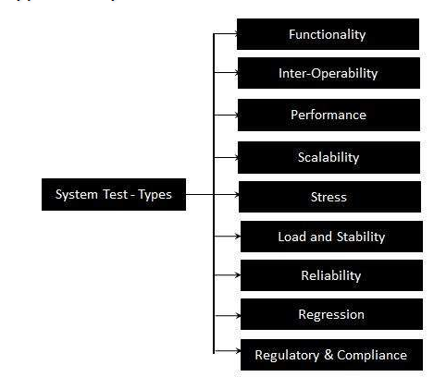
Types of System Tests:

Slide 83
User Acceptance Testing
User acceptance is a type of testing performed by the Client to certify the system with respect to the requirements that was agreed upon. This testing happens in the final phase of testing before moving the software application to Market or Production environment.

Slide 84
The main purpose of this testing is to validate the end to end business flow. It does NOT focus on the cosmetic errors, Spelling mistakes or System testing. This testing is carried out in separate testing environment with production like data setup. It is a kind of black box testing where two or more end users will be involved.

Slide 85
How is UAT Performed Prerequisites of User Acceptance Testing
:Following are the entry criteria for User Acceptance Testing:
Business Requirements must be available.
Application Code should be fully developed
Unit Testing, Integration Testing & System Testing should be completed
No Showstoppers, High, Medium defects in System Integration Test Phase -

Slide 86
Only Cosmetic error are acceptable before UAT
Regression Testing should be completed with no major defects
All the reported defects should be fixed and tested before UAT
Traceability matrix for all testing should be completed
UAT Environment must be ready

Slide 87
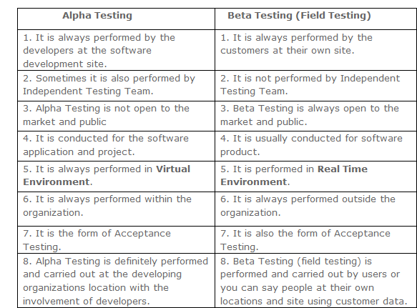

Slide 88
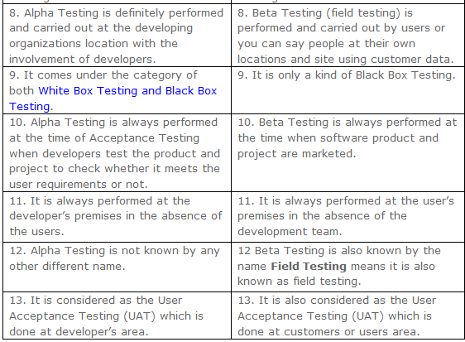

Slide 89
What is Functional Testing?

Slide 90
Functional testing is a type of testing which verifies that each function of the software application operates in conformance with the requirement specification. This testing mainly involves black box testing and it is not concerned about the source code of the application. Each and every functionality of the system is tested by providing appropriate input, verifying the output and comparing the actual results with the expected results. This testing involves checking of User Interface, APIs, Database, security, client/ server applications and functionality of the Application Under Test. The testing can be done either manually or using automation

Slide 91
What do you test in Functional Testing?
The prime objective of Functional testing is checking the functionalities of the software system. It mainly concentrates on -
Mainline functions: Testing the main functions of an application
Basic Usability: It involves basic usability testing of the system. It checks whether an user can freely navigate through the screens without any difficulties.
Accessibility: Checks the accessibility of the system for the user
Error Conditions: Usage of testing techniques to check for error conditions. It checks whether suitable error messages are displayed.

Slide 92
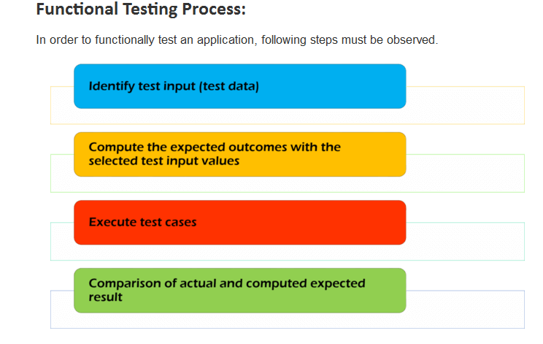

Slide 93
What is Non-Functional Testing?
Non-functional testing is a type of testing to check non-functional aspects (performance, usability, reliability, etc.) of a software application. It is explicitly designed to test the readiness of a system as per nonfunctional parameters which are never addressed by functional testing.
A good example of non-functional test would be to check how many people can simultaneously login into a software.
Non-functional testing is equally important as functional testing and affects client satisfaction.

Slide 94
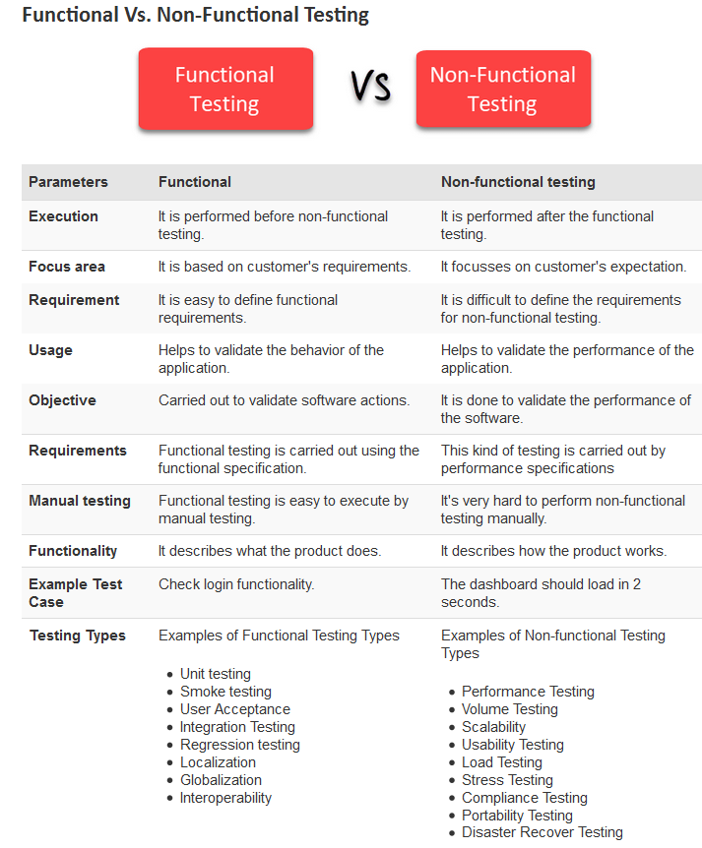

Slide 95
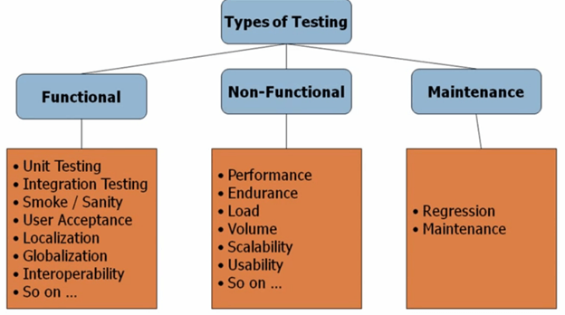

Slide 96
What is Usability Testing? Usability Testing is a type of software testing where, a small set of target end-users, of a software system, "use" it to expose usability defects. This testing mainly focuses on the user's ease to use the application, flexibility in handling controls and ability of the system to meet its objectives. It is also called User Experience Testing. This testing is recommended during the initial design phase of SDLC, which gives more visibility on the expectations of the users.

Slide 97
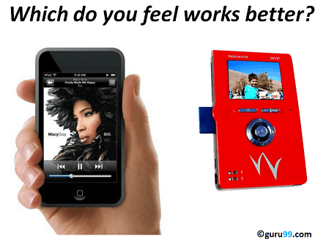
Need for Usability Testing
UsabilityTesting
Aesthetics and design are important. How well a product looks usually determines how well it works.
There are many software applications / websites, which miserably fail, once launched, due to following reasons -
Where do I click next?
Which page needs to be navigated?
Which Icon or Jargon represents what?
Error messages are not consistent or effectively displayed
Session time not sufficient.
Usability Testing identifies usability errors in the system early in development cycle and can save a product from failure.

Slide 98
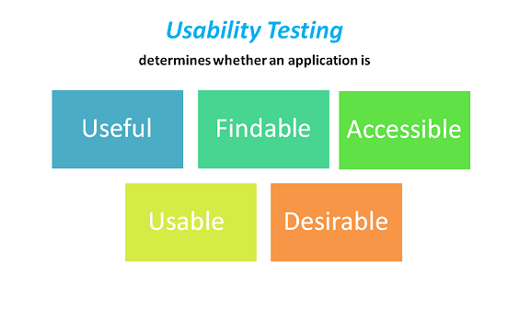
Goals of Usability Testing

Slide 99
What is Performance Testing?
Software Performance testing is type of testing perform to determine the performance of system to major the measure, validate or verify quality attributes of the system like responsiveness, Speed, Scalability, Stability under variety of load conditions.
The system is tested under a mixture of load conditions and check the time required responding by the system under varying workloads.
Software performance testing involves the testing of application under test to ensure that application is working as expected under variety of load conditions.
The goal of performance testing is not only find the bugs in the system but also eliminate the performance bottlenecks from the system.

Slide 100
Why do performance testing?
Before going live in the market, the software system should be tested against the Speed, Stability and scalability under variety of load conditions. If system goes live without doing performance testing may cause the issues like running system slow while simultaneously accessing system by several users, poor usability which likely to gain the bad reputation and it affects the expected sales goal directly.
Performance testing encompasses a range of different tests which enable analysis of various aspects of the system. The Performance testing is tells about what needs to fix before going live (mainly the issues faced under the variety of load conditions).

Slide 101
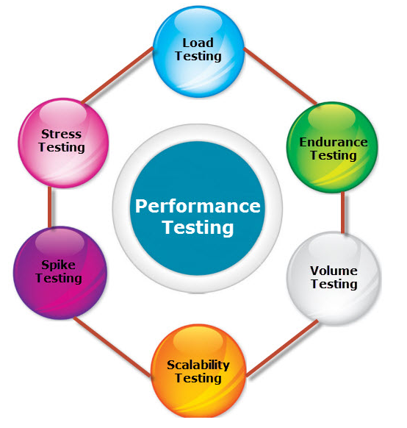
Types of Performance Testing:

Slide 102
1) Load Testing:
Load Testing is type of performance testing to check system with constantly increasing the load on the system until the time load is reaches to its threshold value. Here Increasing load means increasing number of concurrent users, transactions & check the behavior of application under test. It is normally carried out underneath controlled environment in order to distinguish between two different systems. It is also called as “Endurance testing” and “Volume testing”.
The main purpose of load testing is to monitor the response time and staying power of application when system is performing well under heavy load. Load testing comes under the Non Functional Testing & it is designed to test the non-functional requirements of a software application.
Load testing is perform to make sure that what amount of load can be withstand the application under test. The successfully executed load testing is only if the specified test cases are executed without any error in allocated time.

Slide 103
Simple examples of load testing:
Testing printer by sending large job.
Editing a very large document for testing of word processor
Continuously reading and writing data into hard disk.
Running multiple applications simultaneously on server.
Testing of mail server by accessing thousands of mailboxes
In case of zero-volume testing & system fed with zero load.

Slide 104
2) Stress Testing:
Stress Testing is performance testing type to check the stability of software when hardware resources are not sufficient like CPU, memory, disk space etc.
“To determine or validate an application’s behavior when it is pushed beyond normal or peak load conditions.”
Stress testing is Negative testing where we load the software with large number of concurrent users/processes which cannot be handled by the systems hardware resources. This testing is also known as Fatigue testing, this testing should capture the stability of the application by testing it beyond its bandwidth capacity.

Slide 105
The main idea behind stress testing is to determine the failure of system and to keep an eye on how the system gracefully get recover back, this quality is known as recoverability. Stress testing comes under the Non Functional Testing & it is designed to test the non-functional requirements of a software application. This testing is to be carried out under controlled environment before launch, so that we can accurately capture the system behavior under most erratic scenarios

Slide 106
3) Spike testing:
Spike testing is subset of Stress Testing. A spike test is carried out to validate the performance characteristics when the system under test subjected to workload models and load volumes that repeatedly increase beyond anticipated production operations for short periods of time.

Slide 107
4) Endurance testing:
Endurance testing is a non functional type of testing. Endurance testing involves testing a system with a expected amount of load over a long period of time to find the behavior of system.
Let’s take a example where system is designed to work for 3 hrs of time but same system endure for 6 hrs of time to check the staying power of system. Most commonly test cases are executed to check the behavior of system like memory leaks or system fails or random behavior. Sometimes endurance testing is also referred as Soak testing.

Slide 108
5) Scalability Testing:
Scalability Testing is type of non-functional tests and it is the testing of a software application for determine its capability to scale up in terms of any of its non-functional capability like the user load supported, the number of transactions, the data volume etc. The main aim if this testing is to understand at what peak the system prevent more scaling.

Slide 109
6) Volume testing:
Volume testing is non-functional testing which refers to testing a software application with a large amount of data to be processed to check the efficiency of the application.
The main goal of this testing is to monitor the performance of application under varying database volumes.

Slide 110
Top Performance Testing Tools:
WebLOAD
LoadRunner
Apache JMeter
NeoLoad
LoadUI
OpenSTA
WAPT
LoadImpact
Loadster
Httperf
Rational Performance Tester
QEngine (ManageEngine)
Testing Anywhere
CloudTest
Loadstorm

Slide 111
What is Security Testing
Security Testing is a variant of Software Testing which ensures, that system and applications in an organization, are free from any loopholes that may cause a big loss. Security testing of any system is about finding all possible loopholes and weaknesses of the system which might result into a loss of information at the hands of the employees or outsiders of the Organization.

Slide 112

So, basically, you need to test about ‘who you are’ and ‘what you can do’ for distinct users.
Some of the authentication tests include a test for password quality rules, test for default logins, test for password recovery, test captcha, test for logout functionality, test for password change, test for security question/answer, etc.
Similarly, some of the authorization tests include a test for path traversal, test for missing authorization, test for horizontal access control problems, etc.

Slide 113
What is Configuration Testing?
Configuration testing is the method of testing an application with multiple combinations of software and hardware to find out the optimal configurations that the system can work without any flaws or bugs.
As discussed above, Configuration Testing is a software testing where the application under test has to be tested using multiple combinations of Software and Hardware.

Slide 114
Objectives of Configuration Testing
Validating the application to determine if it fulfills the configurability requirements
Manually causing failures which help in identifying the defects that are not efficiently found during testing (Ex: changing the regional settings of the system like Time Zone, Language, Date time formats, etc.)
Determine an optimal configuration of the application under test.
Analyzing the system performance by adding or modifying the hardware resources like Load Balancers, increase or decrease in memory size, connecting various printer models, etc.
Analyzing system Efficiency based on the prioritization, how efficiently the tests were performed with the resources available to achieve the optimal system configuration.
Verification of the system in a geographically distributed Environment to verify how effectively the system performs.For Ex: Server at a different location and clients at a different location, the system should work fine irrespective of the system settings.
Verifying how easily the bugs are reproducible irrespective of the configuration changes.
Ensuring how traceable the application items are by properly documenting and maintaining the versions which are easily identifiable.
Verifying how manageable the application items are throughout the software development life cycle.

Slide 115
What is Compatibility Testing?
Compatibility Testing is a type of Software testing to check whether your software is capable of running on different hardware, operating systems, applications , network environments or Mobile devices.
Compatibility Testing is a type of the Non-functional testing

Slide 116
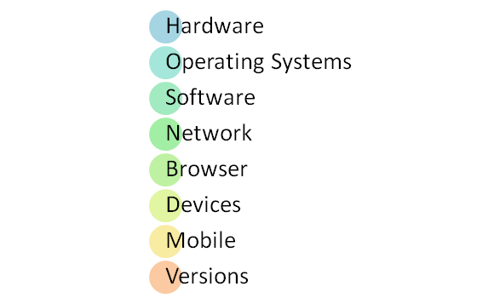
Types of Compatibility Tests

Slide 117
Hardware : It checks software to be compatible with different hardware configurations .
Operating Systems: It checks your software to be compatible with different Operating Systems like Windows , Unix , Mac OS etc.
Software: It checks your developed software to be compatible with other softwares. For example: MS Word application should be compatible with other software like MS Outlook,MS Excel , Vba etc.
Network: Evaluation of performance of system in a network with varying parameters such as Bandwidth, Operating speed, Capacity. It also checks application in different networks with all parameters mentioned earlier.
Browser: It checks compatibility of your website with different browsers like Firefox , Google Chrome , Internet Explorer etc.
Devices : It checks compatibility of your software with different devices like USB port Devices, Printers and Scanners, Other media devices and Blue tooth.
Mobile: Checking your software is compatible with mobile platforms like Android , iOS etc.
Versions of the software: It is verifying you software application to be compatible with different versions of software. For instance checking your Microsoft Word to be compatible with Windows 7, Windows 7 SP1 , Windows 7 SP 2 , Windows 7 SP 3.

Slide 118
What is Recovery Testing?
Recovery Testing is the failure which is forced into an application to check how well the recover process is performed. This can be understood with a simple example of browser. Say we have open a browser with 6 sessions on it. Close it abruptly and re launch it and check whether it is able to recover all those 6 sessions successfully or not.
This is recovery testing for browser. Another example could be of a mobile application say Music download with data network. Download a large music file and in between the download go to a place where is no data network available, download should pause and once you are back in network it should start from the point it was paused (network was lost) not from the beginning.
If it starts again from the beginning then data used before in downloading would be lost and hence it becomes costly to use such application.

Slide 119
Availability testing
Availability of the website is a very unpredictable thing. Sometimes from home (or work) your website is accessible, but your friends can’t enter it. Also there can be a situation when sometimes your website up and sometimes down (and you can’t even prove this). Or website is being loaded very slowly. Solution in each case can be complicated, WEBO Pulsar can help you to prove and analyze each type of such issues.

Slide 120
Unavailability of a large segment of the network
Unavailability of a hoster
Great timeout.
HTTP error on website

Slide 121
What is Globalization (Internationalization) Testing?
Globalization definition: Globalization Testing is testing process to check whether software can perform properly in any locale or culture & functioning properly with all types of international inputs and steps to effectively make your product truly global. This type of testing validates whether the application is capable for using all over the world and to check whether the input accepts all the language texts.
It is also called as “G11N“, because there as 11 characters in between G & N. It ensures that the product will handle international support without breaking functionality. Globalization testing mainly focuses on the functionality of the product with any culture/locale settings and every type of possible international input. It also helps uncover issues that may increase the costs of localization and future product support later on.

Slide 122
What is Localization Testing?
Localization testing is testing process to validate whether application is capable enough for using in a particular location or country. In this testing localization, testing is to carried out to check the quality of the product for particular locale/culture. To check the quality of translation in localization testing, we should request local staff as well. It is to be carried out to check the localized version of the product, For example: French product for French users. It is also called as “L10N“, because there as 10 characters in between L & N.

Slide 123
OTHER TYPES OF TESTING

Slide 124
What is Mutation Testing?
Mutation Testing is a type of software testing where we mutate (change) certain statements in the source code and check if the test cases are able to find the errors. It is a type of White Box Testing which is mainly used for Unit Testing.
The changes in mutant program are kept extremely small, so it does not affect the overall objective of the program.
The goal of Mutation Testing is to assess the quality of the test cases which should be robust enough to fail mutant code. This method is also called as Fault based testing strategy as it involves creating fault in the program

Slide 125
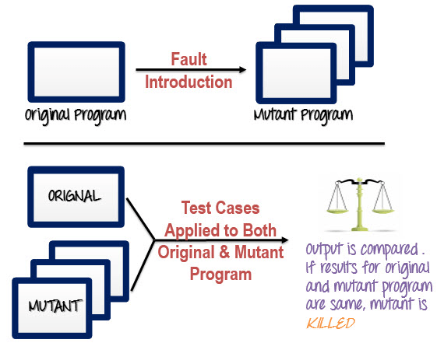
How to execute mutation testing?

Slide 126
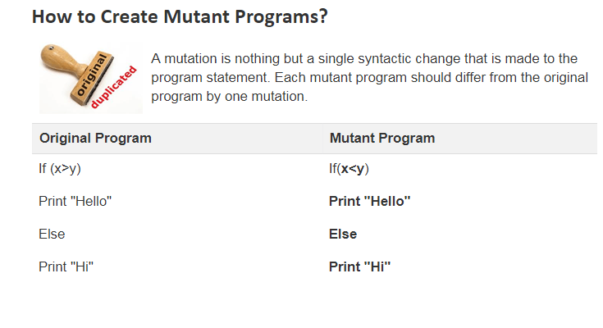

Slide 127
What is Progressive Testing?
Progressive testing also known as incremental testing is used to test modules one after the other. When an application with a hierarchy such as parent-child module is being tested, the related modules would need to be tested first.
This progressive approach testing method has three approaches:
Top-down Approach
Bottom-up Approach
Hybrid Approach

Slide 128
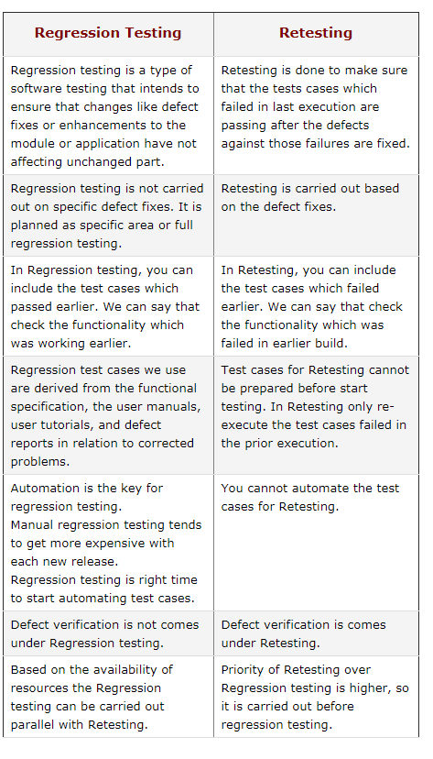
Regression and Retesting

Slide 129
Smoke and Sanity Testing
Smoke and Sanity testing are the most misunderstood topics in Software Testing. There is enormous amount of literature on the subject, but most of them are confusing. The following article makes an attempt to address the confusion.
The key differences between Smoke and Sanity Testing can be learned with the help of following diagram -

Slide 130
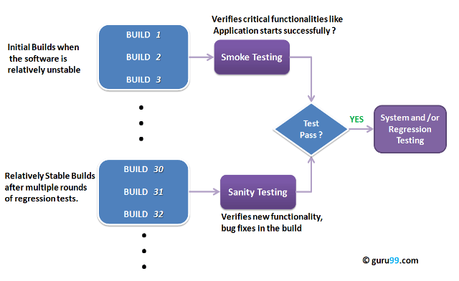

Slide 131
What is Smoke Testing?
Smoke Testing is a kind of Software Testing performed after software build to ascertain that the critical functionalities of the program is working fine. It is executed "before" any detailed functional or regression tests are executed on the software build. The purpose is to reject a badly broken application, so that the QA team does not waste time installing and testing the software application.
In Smoke Testing, the test cases chosen cover the most important functionality or component of the system. The objective is not to perform exhaustive testing, but to verify that the critical functionalities of the system is working fine. For Example a typical smoke test would be - Verify that the application launches successfully, Check that the GUI is responsive ... etc

Slide 132
What is Sanity Testing?
Sanity testing is a kind of Software Testing performed after receiving a software build, with minor changes in code, or functionality, to ascertain that the bugs have been fixed and no further issues are introduced due to these changes. The goal is to determine that the proposed functionality works roughly as expected. If sanity test fails, the build is rejected to save the time and costs involved in a more rigorous testing.
The objective is "not" to verify thoroughly the new functionality, but to determine that the developer has applied some rationality (sanity) while producing the software. For instance, if your scientific calculator gives the result of 2 + 2 =5! Then, there is no point testing the advanced functionalities like sin 30 + cos 50.

Slide 133
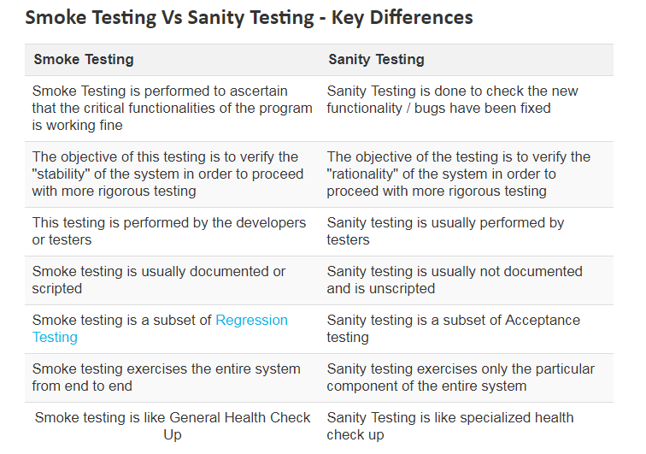

Slide 134
What is a Software Build?
If you are developing a simple computer program which consists of only one source code file, you merely need to compile and link this one file, to produce an executable file. This process is very simple. Usually this is not the case. A typical Software Project consists of hundreds or even thousands of source code files. Creating an executable program from these source files is a complicated and time-consuming task. You need to use "build" software to create an executable program and the process is called " Software Build"

Slide 135
Maintenance Testing
Maintenance Testing is done on the already deployed software. The deployed software needs to be enhanced, changed or migrated to other hardware. The Testing done during this enhancement, change and migration cycle is known as maintenance testing.
Once the software is deployed in operational environment it needs some maintenance from time to time in order to avoid system breakdown, most of the banking software systems needs to be operational 24*7*365. So it is very necessary to do maintenance testing of software applications.
In maintenance testing, tester should consider 2 parts.
Any changes made in software should be tested thoroughly.
The changes made in software does not affect the existing functionality of the software, so regression testing is also done.

Slide 136
Why is Maintenance Testing required
User may need some more new features in the existing software which requires modifications to be done in the existing software and these modifications need to be tested.
End user might want to migrate the software to other latest hardware platform or change the environment like OS version, Database version etc. which requires testing the whole application on new platforms and environment.

